Slide 1
Chapter 12
Physical Properties of Solutions

Slide 2

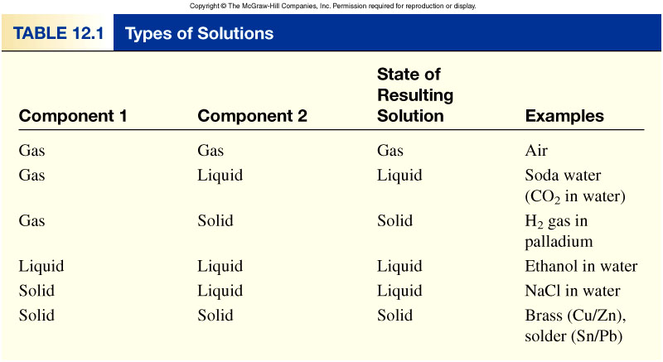
A solution is a homogenous mixture of 2 or more substances.
The solute is(are) the substance(s) present in the smaller amount(s).
The solvent is the substance present in the larger amount.
12.1

Slide 3
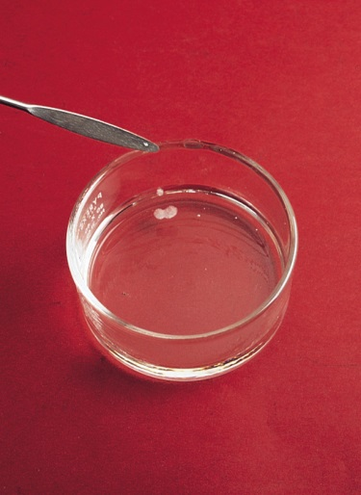
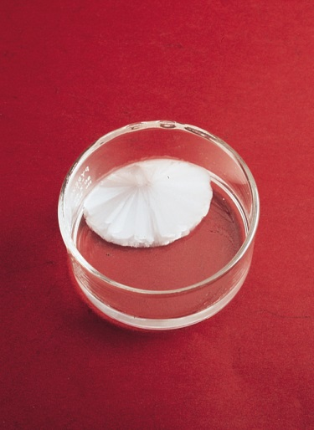
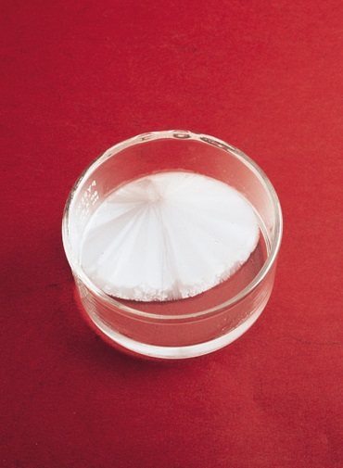
A saturated solution contains the maximum amount of a solute that will dissolve in a given solvent at a specific temperature.
An unsaturated solution contains less solute than the solvent has the capacity to dissolve at a specific temperature.
Sodium acetate crystals rapidly form when a seed crystal is
added to a supersaturated solution of sodium acetate.
12.1

Slide 4

“like dissolves like”
Two substances with similar intermolecular forces are likely to be soluble in each other.
non-polar molecules are soluble in non-polar solvents
    CCl₄ in C₆H₆
polar molecules are soluble in polar solvents
    C₂H₅OH in H₂O
ionic compounds are more soluble in polar solvents
    NaCl in H₂O or NH₃ (l)
12.2

Slide 5
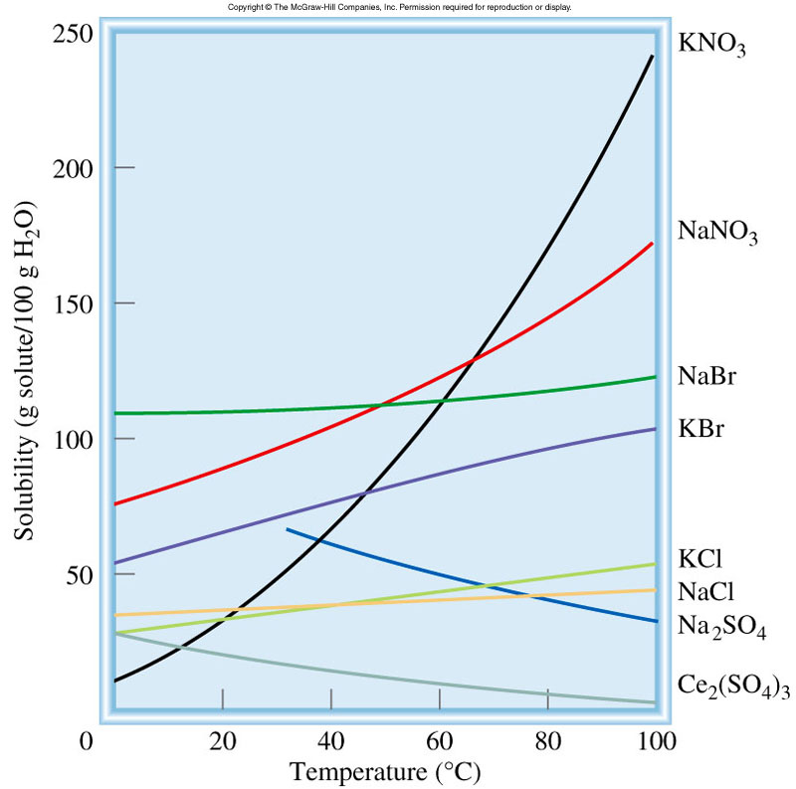
Temperature and Solubility
Solid solubility and temperature
solubility increases with increasing temperature
solubility decreases with increasing temperature
12.4

Slide 6
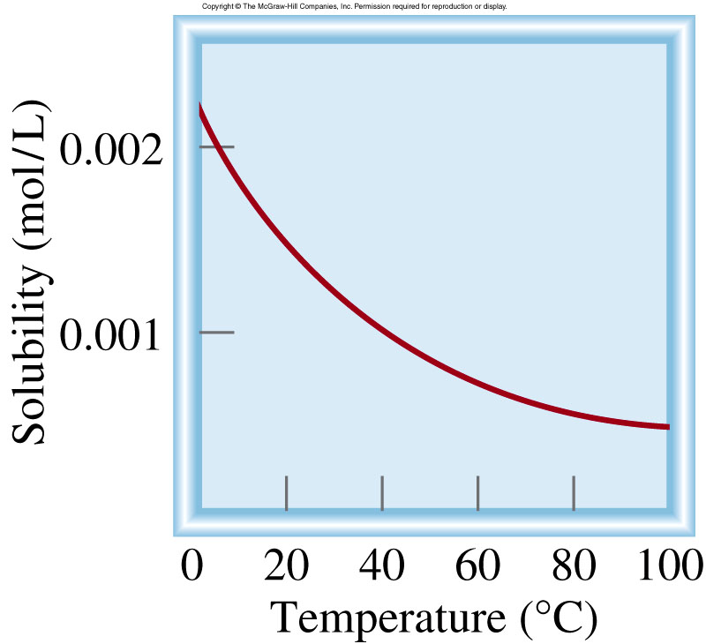
Temperature and Solubility
O₂ gas solubility and temperature
solubility usually decreases with increasing temperature
12.4

Slide 7

Concentration Units
The concentration of a solution is the amount of solute present in a given quantity of solvent or solution.
Molarity (M) or molar concentration, which is the number of moles of solute per liter of solution.
moles of solute
M =
liters of solution
Molality (m) is the number of moles of solute dissolved in 1 kg (1000 g) of solvent
moles of solute
m =
mass of solvent (kg)
12.3

Slide 8
Comparison of Concentration Units
The advantage of molarity is that it is generally easier to measure the volume of a solution.
For this reason, molarity is often preferred over molality.
Molality is independent of temperature, because the concentration is expressed in number of moles of solute and mass of solvent.
The volume of a solution typically increases with increasing temperature, so that a solution that is 1.0 M at 25°C may become 0.97 M at 45°C because of the increase in volume on warming.
This concentration dependence on temperature can significantly affect the accuracy of an experiment.
Therefore, it is sometimes preferable to use molality instead of molarity.

Slide 9
What mass of KI is required to make 500. mL of a 2.80 M KI solution?
M KI
M KI
volume of KI solution
moles KI
grams KI
1 L
2.80 mol KI
166 g KI
500. mL
x
x
x
= 232 g KI
1000 mL
1 L soln
1 mol KI

Slide 10
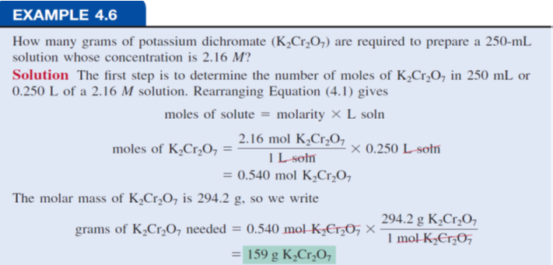


Slide 11
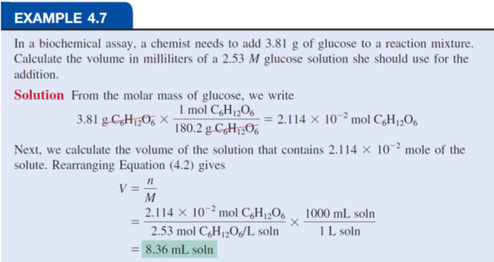



Slide 12
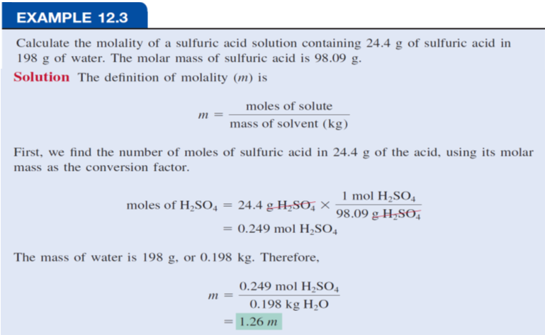




Slide 13







Percent by Mass The percent by mass (also called percent by weight or weight percent) is the ratio of the mass of a solute to the mass of the solution, multiplied by 100 percent:
mass of solute
% by mass =
x 100%
mass of solute + mass of solvent
mass of solute
=
x 100%
mass of solution
Mole Fraction (X) The mole fraction of a component of a solution, say, component A, is written X_{A} and is defined as
moles of A
X_{A} =
sum of moles of all components
12.3

Slide 14
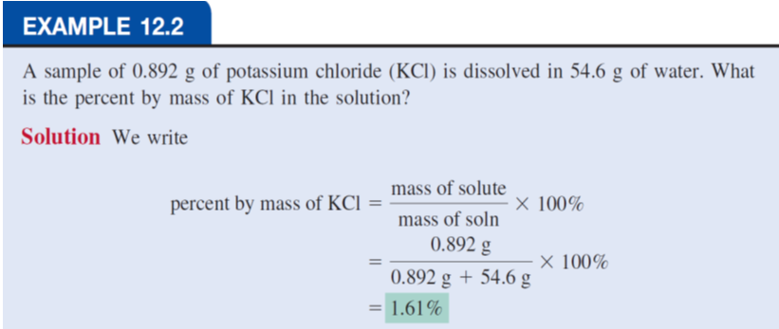

Slide 15
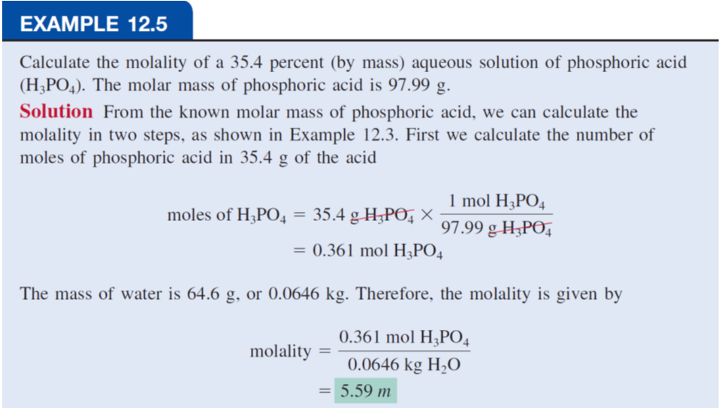



Slide 16
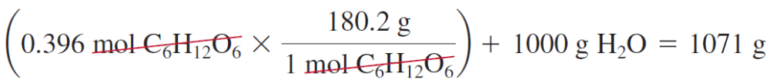
To convert one concentration unit of a solution to another
Example;
Express the concentration of a 0.396 m glucose (C₆H₁₂O₆) solution in molarity? (density of solution=1.16 g/mL)
0.396 m glucose (C₆H₁₂O₆) i.e. there is 0.396 mole of glucose in 1000 g of the solvent.
To calculate molarity; we need to determine the volume of this solution.
First, we calculate the mass of the solution from the molar mass of glucose:

Slide 17
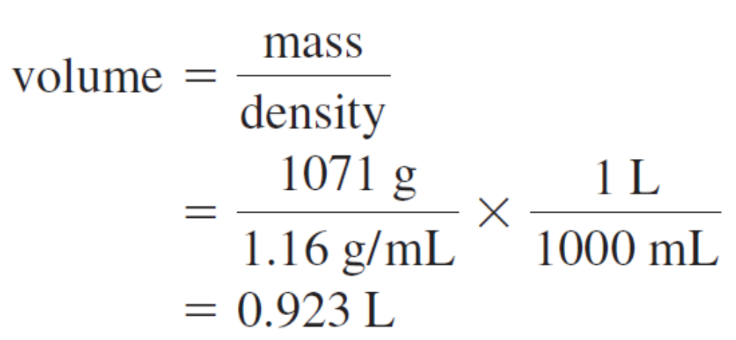
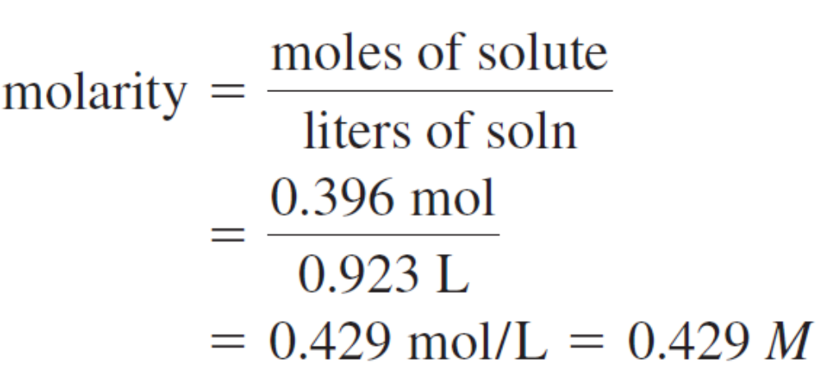
The density of the solution is1.16 g/mL.
We can now calculate the volume of the solution in liters
The molarity of the solution is given by

Slide 18




What is the molality of a 5.86 M ethanol (C₂H₅OH) solution whose density is 0.927 g/mL?
moles of solute
moles of solute
m =
M =
mass of solvent (kg)
liters of solution
Assume 1 L of solution:
  5.86 moles ethanol = 270 g ethanol
  927 g of solution (1000 mL x 0.927 g/mL)
mass of solvent = mass of solution – mass of solute
= 927 g – 270 g = 657 g = 0.657 kg
moles of solute
5.86 moles C₂H₅OH
m =
=
= 8.92 m
mass of solvent (kg)
0.657 kg solvent
12.3

Slide 19
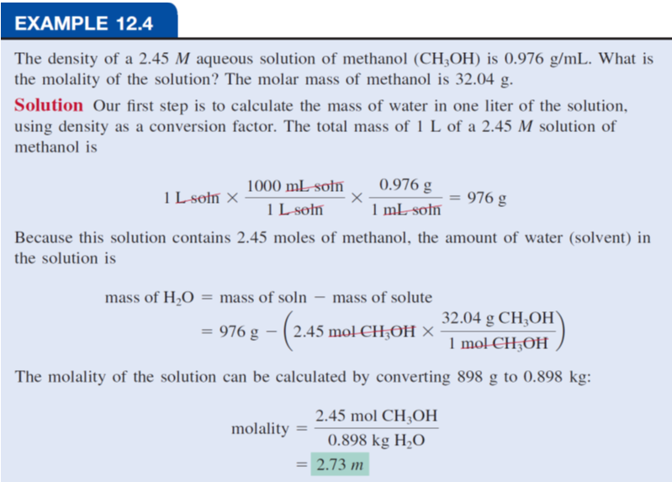


Slide 20
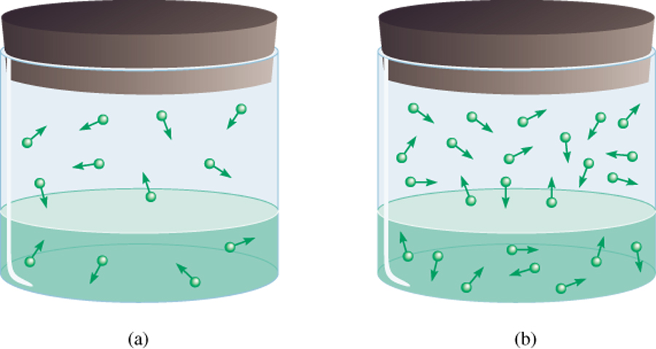
Pressure and Solubility of Gases
The solubility of a gas in a liquid is proportional to the pressure of the gas over the solution (Henry’s law).
c is the concentration (M) of the dissolved gas
c = k_{H} P
P is the pressure of the gas over the solution
k_{H} is a constant for each gas (mol/L•atm) that depends only on temperature
low P
high P
low c
high c
12.5

Slide 21



Most gases obey Henry’s law, but there are some important exceptions.
For example, if the dissolved gas reacts with water, higher solubilities can result.
The solubility of ammonia is much higher than expected because of the reaction
Carbon dioxide also reacts with water, as follows:
Another interesting example is the dissolution of molecular oxygen in blood.

Slide 22
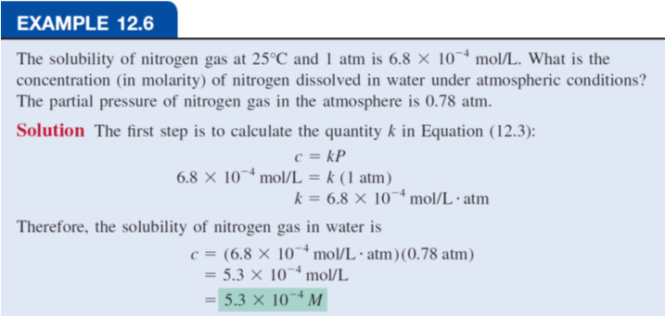

Slide 23
Colligative Properties of Nonelectrolyte Solutions
Colligative properties are properties that depend only on the number of solute particles in solution and not on the nature of the solute particles.
The colligative properties are
vapor-pressure lowering,
boiling-point elevation,
freezing-point depression,
osmotic pressure.
12.6

Slide 24
Vapor-Pressure Lowering
0
0
P ₁
P₁ = X₁ P ₁
= vapor pressure of pure solvent
Raoult’s law
X₁ = mole fraction of the solvent
If the solution contains only one solute:
X₁ = 1 – X₂
0
- P₁ = ΔP = X₂
0
X₂ = mole fraction of the solute
P ₁
P ₁
We see that the decrease in vapor pressure, ΔP, is directly proportional to the solute concentration (measured in mole fraction).
12.6

Slide 25
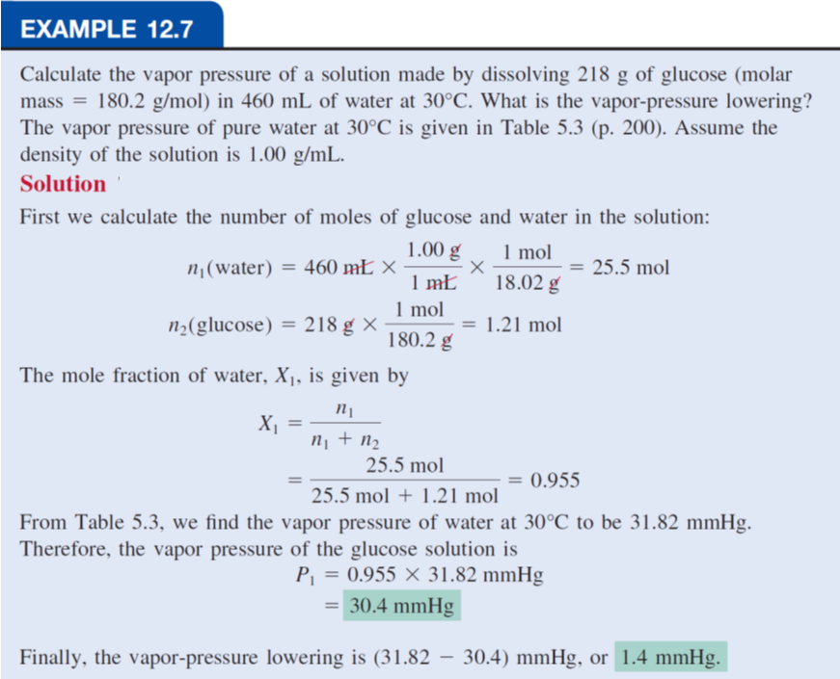

Slide 26
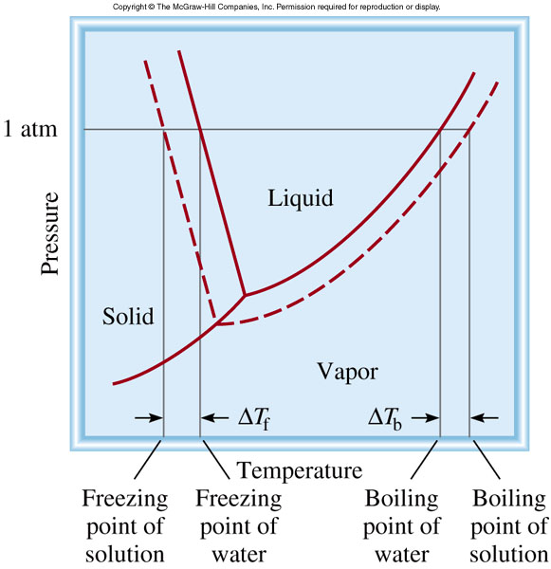
Boiling-Point Elevation
0
ΔT_{b} = T_{b} – T _{b}
0
T _{b} is the boiling point of
the pure solvent
T _{b} is the boiling point of
the solution
0
ΔT_{b} > 0
T_{b} > T _{b}
ΔT_{b} = K_{b} m
m is the molality of the solution
K_{b} is the molal boiling-point
elevation constant (⁰C/m)
for a given solvent
12.6

Slide 27
Freezing-Point Depression
0
ΔT_{f} = T _{f} – T_{f}
0
T _{f} is the freezing point of
the pure solvent
T _{f} is the freezing point of
the solution
0
ΔT_{f} > 0
T _{f} > T_{f}
ΔT_{f} = K_{f} m
m is the molality of the solution
K_{f} is the molal freezing-point
depression constant (⁰C/m)
for a given solvent
12.6

Slide 28
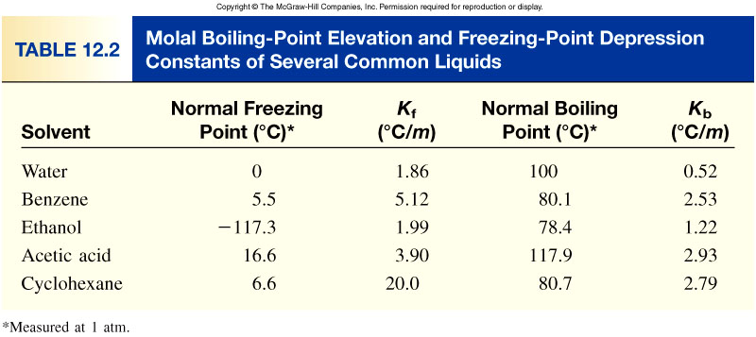


12.6

Slide 29
What is the freezing point and the boiling point of a solution containing 478 g of ethylene glycol (antifreeze) in 3202 g of water? The molar mass of ethylene glycol is 62.01 g/mol.
K_{b} water = 0.52 0C/m
K_{f} water = 1.86 0C/m
ΔT_{f} = K_{f} m
1 mol
478 g x
moles of solute
62.01 g
m =
=
= 2.41 m
mass of solvent (kg)
3.202 kg solvent
ΔT_{f} = K_{f} m
= 1.86 ⁰C/m x 2.41 m = 4.48 ⁰C
0
T_{f} = T _{f} – ΔT_{f}
= 0.00 ⁰C – 4.48 ⁰C = -4.48 ⁰C
ΔT_{b} = K_{b} m
=0.52⁰C/m x 2.41 m = 1.25 ⁰C
0
= 1.25 ⁰C + 100 ⁰C = 101.25⁰C
T_{b} = ΔT_{b} + T _{b}
12.6

Slide 30
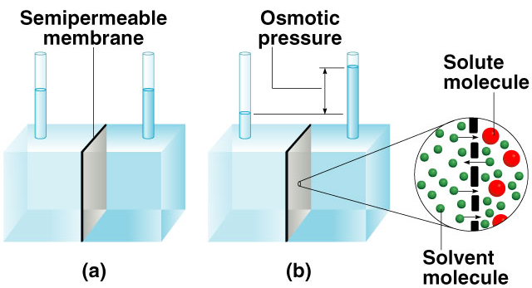
Osmotic Pressure (π)
Osmosis is the selective passage of solvent molecules through a porous membrane from a dilute solution to a more concentrated one.
A semipermeable membrane allows the passage of solvent molecules but blocks the passage of solute molecules.
Osmotic pressure (π) is the pressure required to stop osmosis.
more
concentrated
dilute
12.6

Slide 31
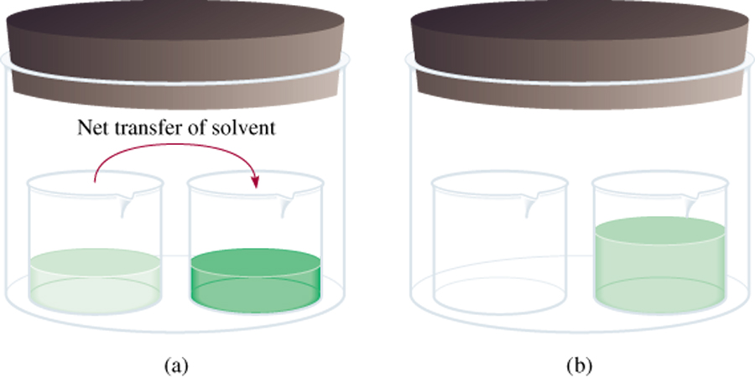
Osmotic Pressure (π)
High
P
Low
P
π = MRT
M is the molarity of the solution
R is the gas constant
T is the temperature (in K)
12.6

Slide 32
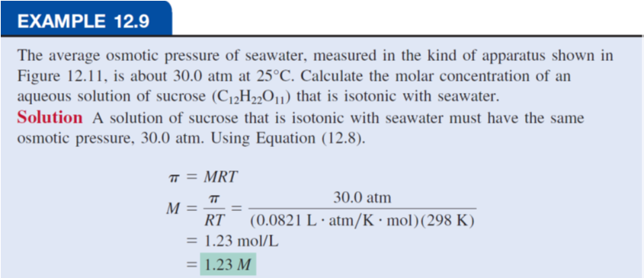

Slide 33
Summary - Colligative Properties of
Nonelectrolyte Solutions
Colligative properties are properties that depend only on the number of solute particles in solution and not on the nature of the solute particles.
0
Vapor-Pressure Lowering
P₁ = X₁ P ₁
Boiling-Point Elevation
ΔT_{b} = K_{b} m
Freezing-Point Depression
ΔT_{f} = K_{f} m
Osmotic Pressure (π)
π = MRT
Using Colligative Properties to Determine Molar Mass
From the experimentally determined freezing-point depression or osmotic pressure, We can calculate the molality or molarity of the solution. Knowing the mass of the solute, we can readily determine its molar mass,
12.6

Slide 34
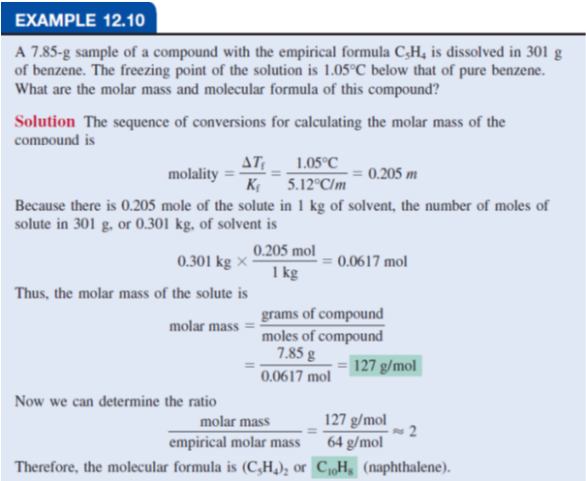

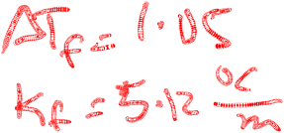

Slide 35
